Slide 1
Industry Wise Sanctions Analysis (2023–2024)
Source: data.gov.in

Slide 2
Introduction
- Analysis of financial sanctions across industries for FY 2023–24
- Dataset Source: data.gov.in
- Key focus: Revenue, Expenditure, and Investments (₹ in crore)
- Insights into sectoral performance and distribution

Slide 3
Domain Knowledge
- Covers sectors like Manufacturing, Agriculture, IT, Mining, Services, Healthcare, etc.
- Financial figures represent revenue generation or investment
- Understanding these trends helps economic policy and budgeting

Slide 4
Dataset Overview
- Dataset loaded from CSV using pandas
- Columns: Sl_No, Industry, Rs in crore
- Removed irrelevant columns & cleaned missing data
- Converted data types and renamed columns for clarity

Slide 5
Data Cleaning Steps
- Dropped empty columns (Unnamed: 3-7)
- Removed rows with missing Industry values
- Renamed 'Sl No' to 'Sl_No', converted to integer
- Verified column datatypes post-cleaning

Slide 6
Visual Analysis Overview
- Industry-wise Revenue Bar Plot
- Scatter Plot (Industry vs Revenue)
- Line Plot & Box Plot
- Pie Charts: Top 10 Industries, Total Revenue Share
- Area Plot & Cumulative Revenue Plot
- Histograms: Revenue Distribution, Small vs Large Industries
- Revenue Comparison Charts

Slide 7
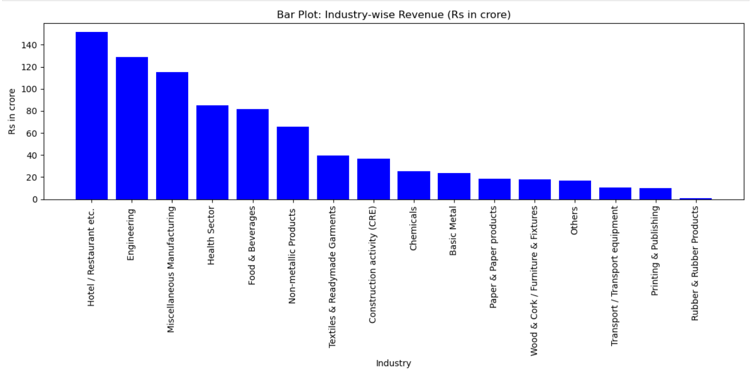
Industry-wise Revenue (Bar Chart)

Slide 8
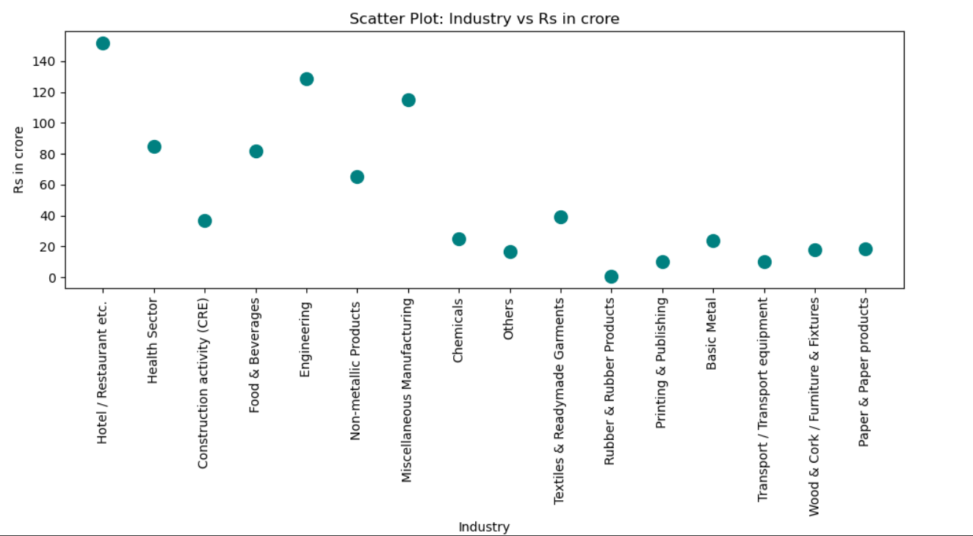
Scatter Plot: Industry vs Revenue

Slide 9
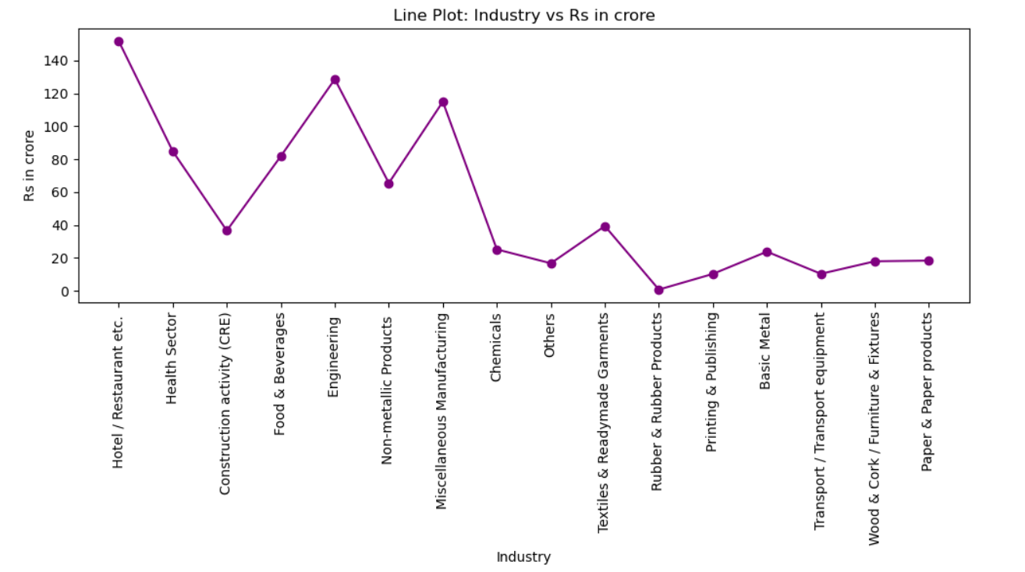
Line Plot: Revenue per Industry

Slide 10
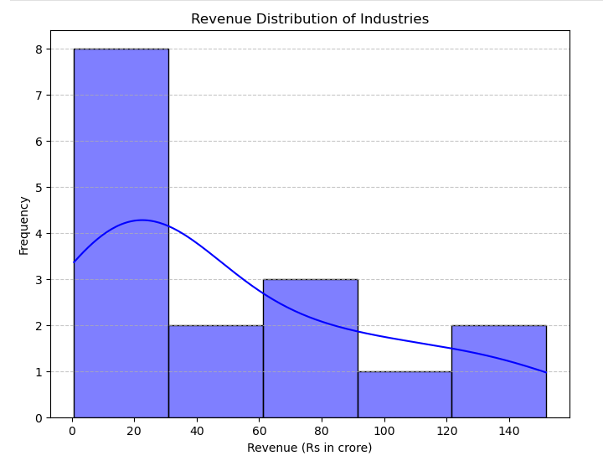
Histogram: Revenue Distribution

Slide 11
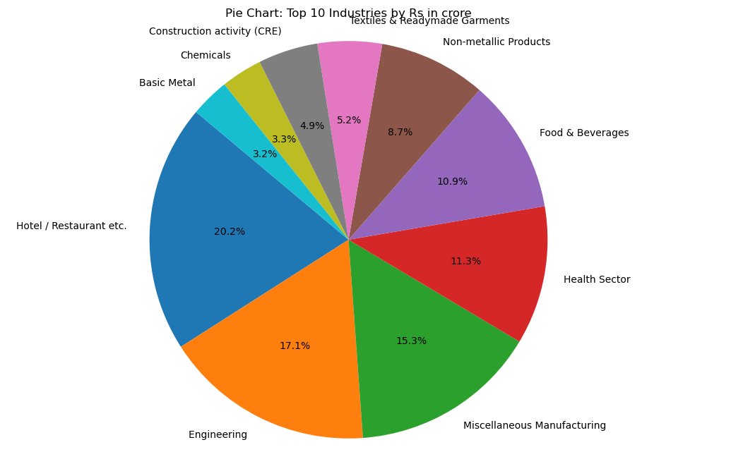
Pie Chart: Top 10 Industries by Revenue

Slide 12
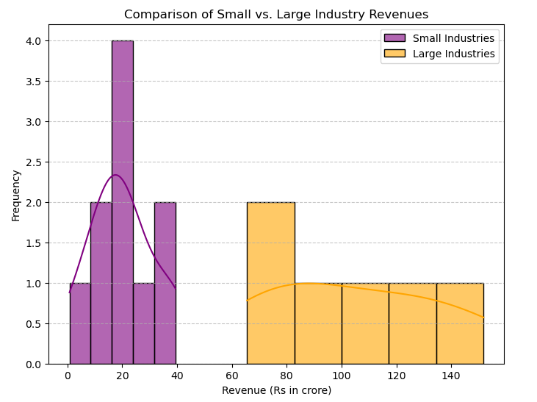
Histogram: Small vs Large Industries

Slide 13
Key Observations
- High revenue concentration in a few dominant industries
- Wide distribution of revenue values
- Notable differences between small and large industries
- Year-over-Year comparisons show varying trends
- Pie charts show disproportionate revenue contributions

Slide 14
Conclusion
- Dataset reveals key industry-wise financial insights
- Visuals highlight sectoral trends and disparities
- Useful for planning, budgeting, and economic forecasting

